Slide 1

3.5
Graphing Linear Equations in Slope-Intercept Form
How can you describe the graph of the equation $y=mx+b$?
Students will be able to find the slope of a line.
Students will be able to use slope-intercept form to graph a linear equation.

Slide 2
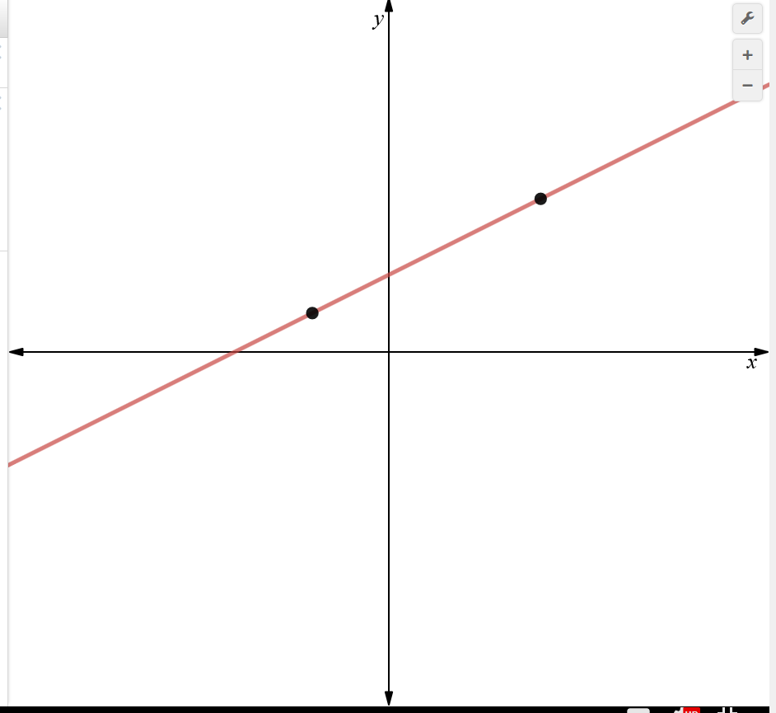





Students will be able to find the slope of a line.
The slope m of a non-vertical line passing through two point $(x_{1},y_{1})$ and $(x_{2},y_{2})$ is the ratio of the rise (change in y) to the run (change in x).
Slope = m = $\frac{rise}{run}=\frac{change in y}{change in x}=\frac{∆y}{∆x}=\frac{y_{2}−y_{1}}{x_{2}−x_{1}} or \frac{y_{1}−y_{2}}{x_{1}−x_{2}}$
run $=x_{2}−x_{1}$
$${(x}_{2},y_{2})$$
rise $=y_{2}−y_{1}$
$${(x}_{1},y_{1})$$

Slide 3
Students will be able to find the slope of a line.
When the line rise from left to right, the slope is positive.
When the line falls from left to right, the slope is negative.

Slide 4
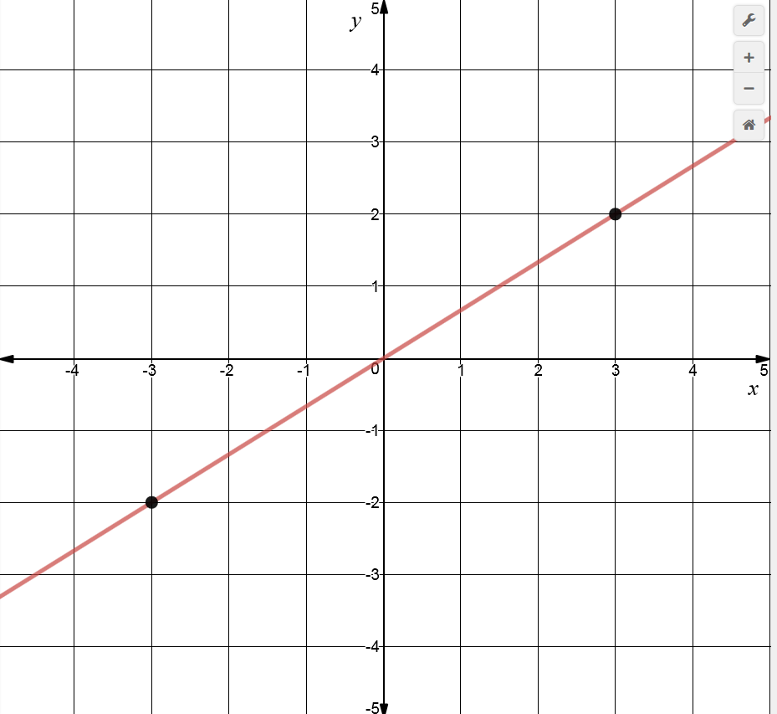





Students will be able to find the slope of a line.
Describe the slope of each line. Then find the slope.
The line rises from left to right.
So, the slope is positive.
m = $\frac{y_{2}−y_{1}}{x_{2}−x_{1}}=\frac{2−(−2)}{3−(−3)}=\frac{4}{6}=\frac{2}{3}$
run $=3−(−3)$
$$(3,2)$$
rise $=2−(−2)$
$$(−3,−2)$$

Slide 5


Students will be able to find the slope of a line.
I prefer to line my points up and then subtract.
$$(3 , 2)$$
$$−(−3,−2)$$
But instead of subtracting, I add the opposite.
$$(3 , 2)$$
$$\underline{+(+3,+2) }$$
$$6 4$$
$$∆x ∆y$$
run $=3−(−3)$
$$(3,2)$$
rise $=2−(−2)$
$$(−3,−2)$$
m = $\frac{∆y}{∆x}=\frac{4}{6}=\frac{2}{3}$

Slide 6
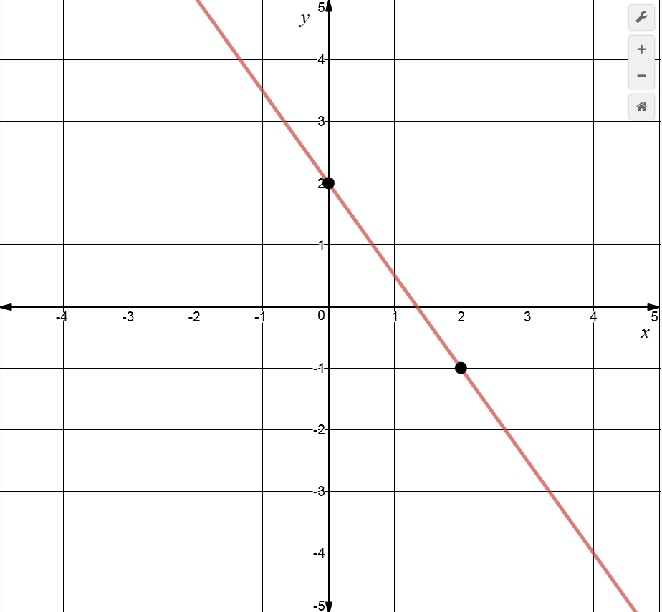





Students will be able to find the slope of a line.
Describe the slope of each line. Then find the slope.
The line falls from left to right.
So, the slope is negative.
m = $\frac{y_{2}−y_{1}}{x_{2}−x_{1}}=\frac{(−1)−2}{2−0}=\frac{−3}{2}=−\frac{3}{2}=\frac{3}{−2}$
$$(0,2)$$
rise $=(−1)−2$
$$(2,−1)$$
run $=2−0$

Slide 7




Students will be able to find the slope of a line.
I prefer to line my points up and then subtract.
$$(2 , −1)$$
$$−(0 , 2)$$
But instead of subtracting, I add the opposite.
$$(2 , −1)$$
$$\underline{+(0 ,− 2) }$$
$$2 −3$$
$$∆x ∆y$$
$$(0,2)$$
rise $=(−1)−2$
$$(2,−1)$$
run $=2−0$
m = $\frac{∆y}{∆x}=\frac{−3}{2}=−\frac{3}{2}$

Slide 8
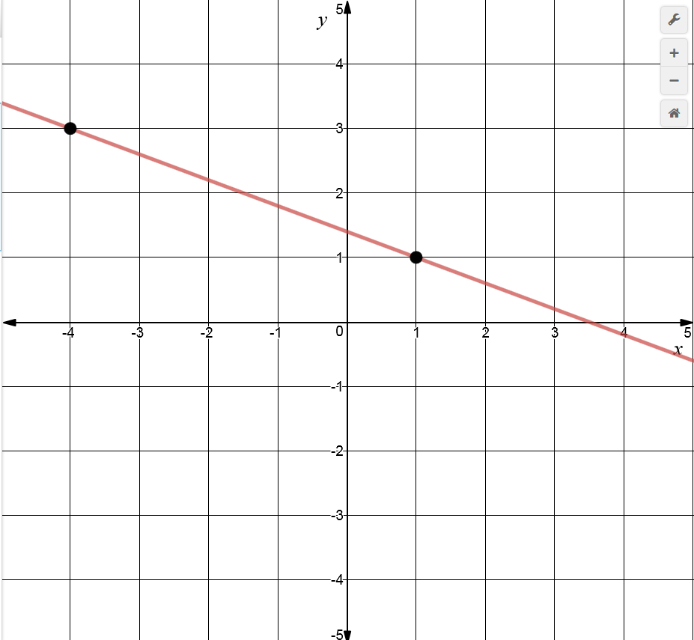









You Try!!
Students will be able to find the slope of a line.
Describe the slope of each line. Then find the slope.
The line falls from left to right.
So, the slope is negative.
m = $\frac{y_{2}−y_{1}}{x_{2}−x_{1}}=\frac{1−3}{1−(−4)}=\frac{−2}{5}=−\frac{2}{5}=\frac{2}{−5}$
$$(−4,3)$$
rise $=1−$3
$$(1,1)$$
run $=1−(−4)$
$$(1 , 1)$$
$$−(−4, 3)$$
$$(1 ,1)$$
$$\underline{+(+4,−3) }$$
$$5 −2$$
$$∆x ∆y$$
$$\text{m} =\frac{∆y}{∆x}=\frac{−2}{5}=−\frac{2}{5}$$

Slide 9
Students will be able to find the slope of a line.
The points represented by each table lie on a line.
How can you find the slope of each line from the table?
What is the slope of each line?
x | y
4 | 20
7 | 14
10 | 8
13 | 2
x | y
-1 | 2
1 | 2
3 | 2
5 | 2
x | y
-3 | -3
-3 | 0
-3 | 6
-3 | 9
Choose any two points from the table and use the slope formula.

Slide 10




Students will be able to find the slope of a line.
The points represented by each table lie on a line.
How can you find the slope of each line from the table?
What is the slope of each line?
Choose any two points from the table and use the slope formula.
x | y
4 | 20
7 | 14
10 | 8
13 | 2
$$(4 ,20)$$
$$−(7,14)$$
$$(4 , 20)$$
$$\underline{+(−7,−14) }$$
$$−3 6$$
$$∆x ∆y$$
$$\text{m} =\frac{∆y}{∆x}=\frac{6}{−3}=−2$$

Slide 11



Students will be able to find the slope of a line.
The points represented by each table lie on a line.
How can you find the slope of each line from the table?
What is the slope of each line?
Choose any two points from the table and use the slope formula.
x | y
-1 | 2
1 | 2
3 | 2
5 | 2
$$(1 ,2)$$
$$−(3,2)$$
$$(1 , 2)$$
$$\underline{+(−3,−2) }$$
$$−2 0$$
$$∆x ∆y$$
Note that there is no change in y.
What kind of line is this?
Horizontal
A Horizontal line has zero slope
$$\text{m} =\frac{∆y}{∆x}=\frac{0}{−2}=0$$

Slide 12



Students will be able to find the slope of a line.
The points represented by each table lie on a line.
How can you find the slope of each line from the table?
What is the slope of each line?
Choose any two points from the table and use the slope formula.
x | y
-3 | -3
-3 | 0
-3 | 6
-3 | 9
$$(−3,9)$$
$$−(−3,0)$$
$$(−3 ,9)$$
$$\underline{+( 3, 0) }$$
$$0 9$$
$$∆x ∆y$$
Note that there is no change in x.
What kind of line is this?
Vertical
A Vertical line has undefined slope or no slope.
$\text{m} =\frac{∆y}{∆x}=\frac{9}{0}=$ undefined or no slope

Slide 13
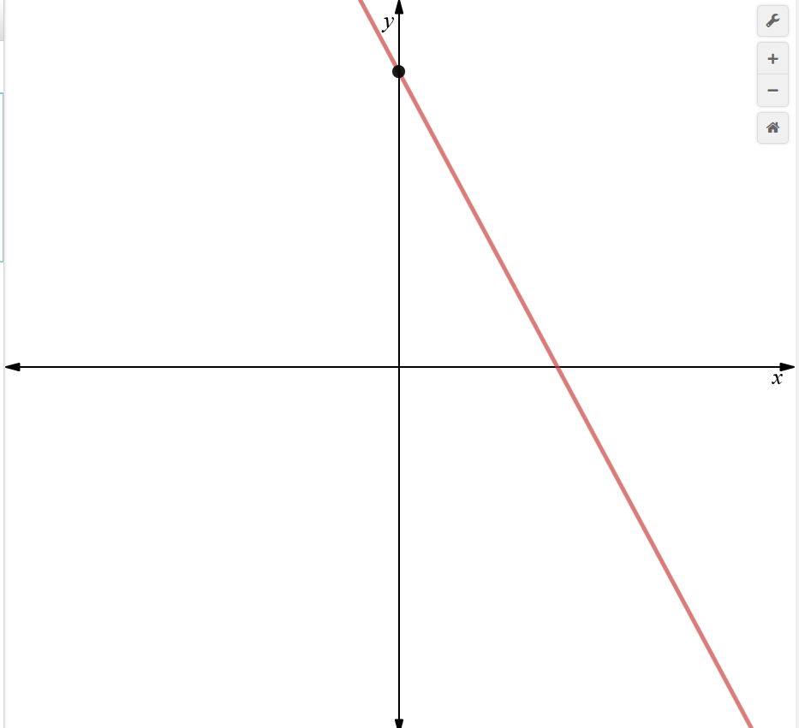




2. Students will be able to use slope-intercept form to graph a linear equation.
A linear equation written in the form $y=mx+b$ is in slope-intercept form.
The slope of the line is m, and the y-intercept of the line is b.
$$y=mx+b$$
$$(0,b)$$
$$y=mx+b$$
slope
y-intercept
A linear equation written in form $y=0x+b$, or $y=b$, is a constant function.
The graph of a constant function is a horizontal line.

Slide 14






2. Students will be able to use slope-intercept form to graph a linear equation.
Find the slope and the y-intercept of the graph of each linear equation.
$$y=3x−4$$
$$y=3x+(−4)$$
$$y=6.5$$
$$y=0x+6.5$$
$$−5x−y=−2$$
$$y=−5x+2$$
y-intercept
y-intercept
y-intercept
slope
slope
slope
$$y=mx+b$$
$$y=mx+b$$
$$y=mx+b$$
Slope = 3
y-intercept = -4
Slope = 0
y-intercept = 6.5
Slope = -5
y-intercept = 2

Slide 15




You Try!!
2. Students will be able to use slope-intercept form to graph a linear equation.
Find the slope and the y-intercept of the graph of each linear equation.
$$y=−6x+1$$
$$y=8$$
$$y=0x+8$$
$$x+4y=−10$$
$$y=−\frac{1}{4}x−\frac{5}{2}$$
Slope = -6
y-intercept = 1
Slope = 0
y-intercept = 8
Slope $=−\frac{1}{4}$
y-intercept $=−\frac{5}{2}$

Slide 16
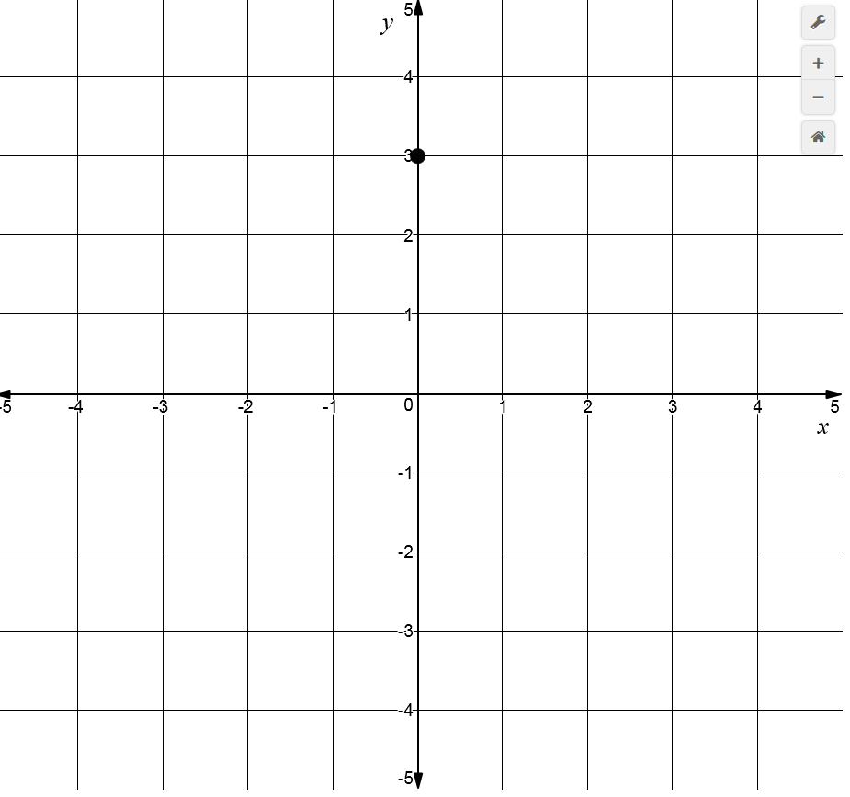
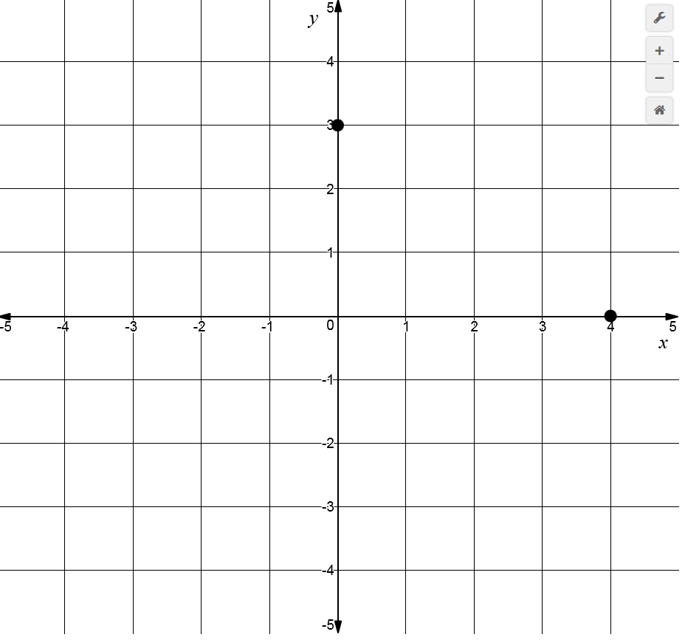
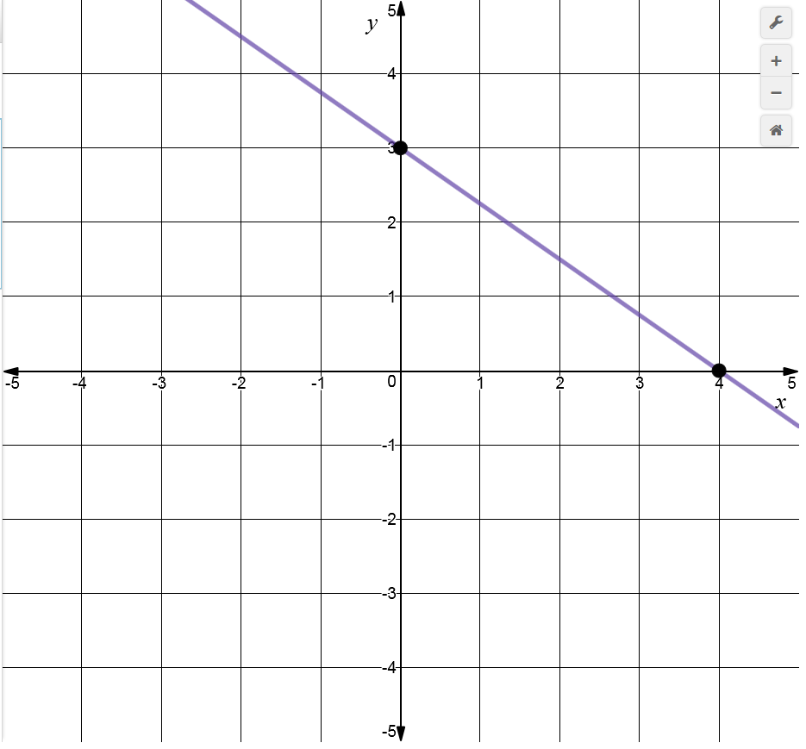





2. Students will be able to use slope-intercept form to graph a linear equation.
Graph $y=−\frac{3}{4}x+3$.
Find the slope and y-intercept
$$(0,3)$$
Slope $=−\frac{3}{4}$
y-intercept = 3
Plot the y-intercept
Use the slope to find another point
Slope $= \frac{rise}{run}=−\frac{3}{4}=\frac{3}{−4}=\frac{−3}{4}$
Draw a line through the two points
rise $=−$3
run $=4$
$$(4,0)$$

Slide 17
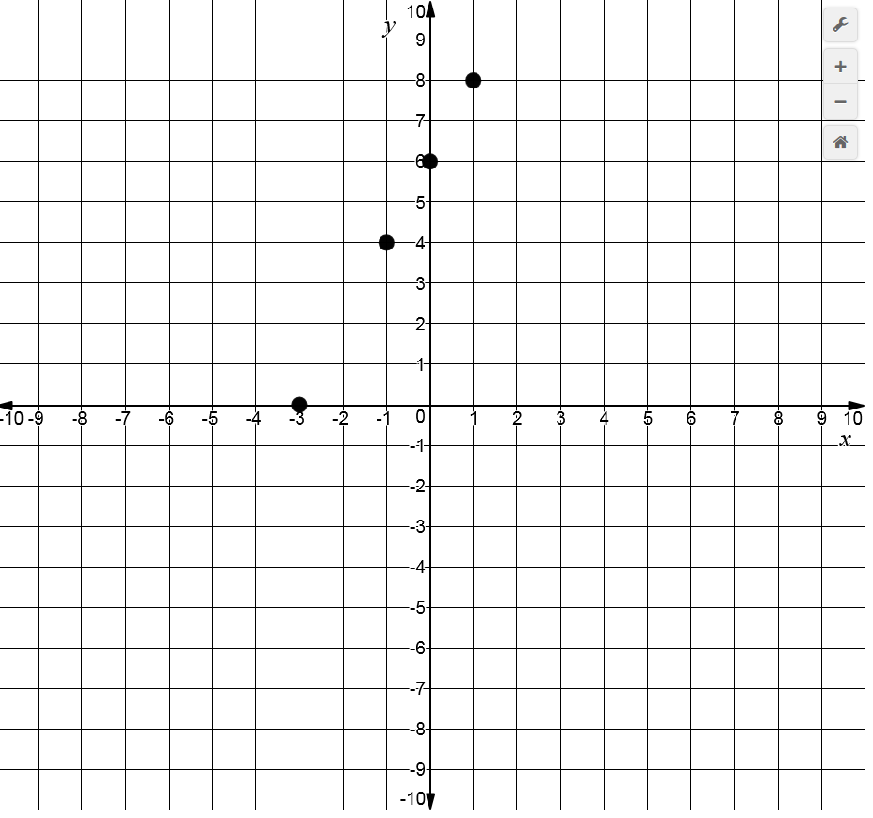
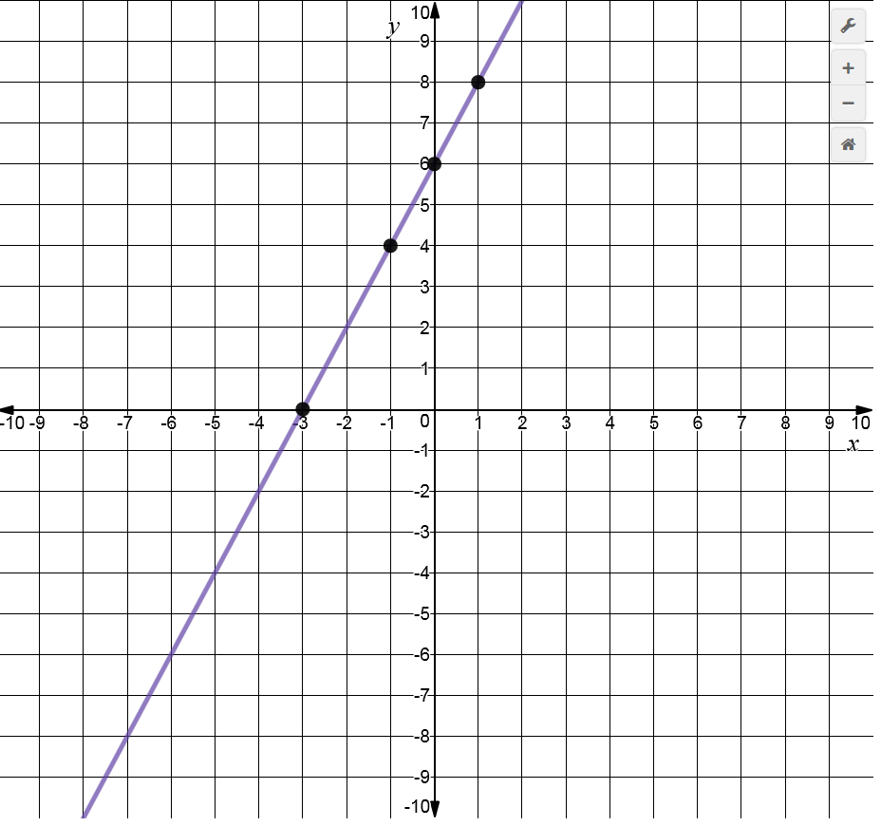
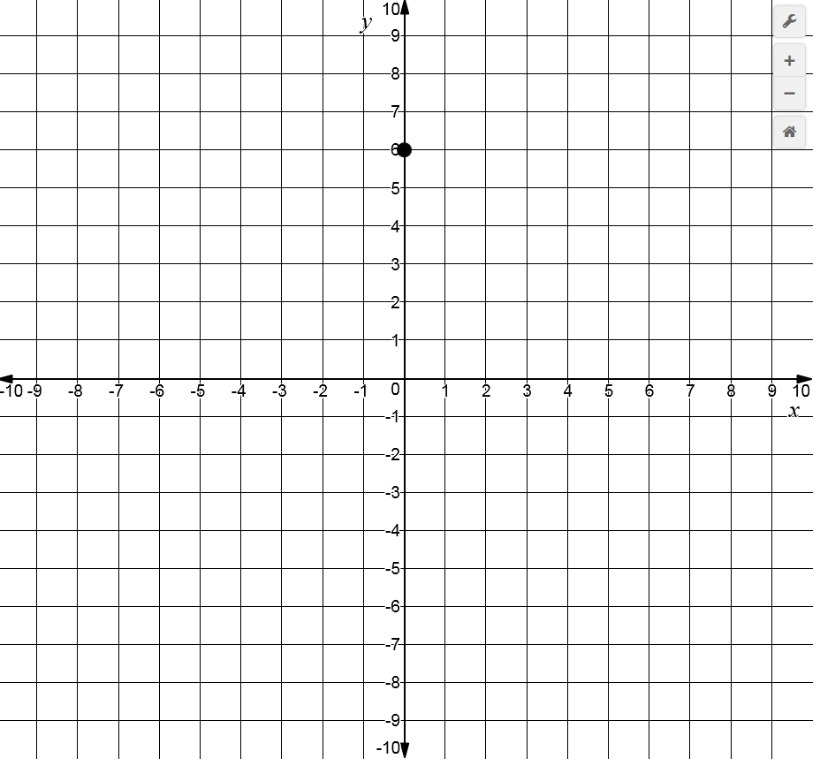
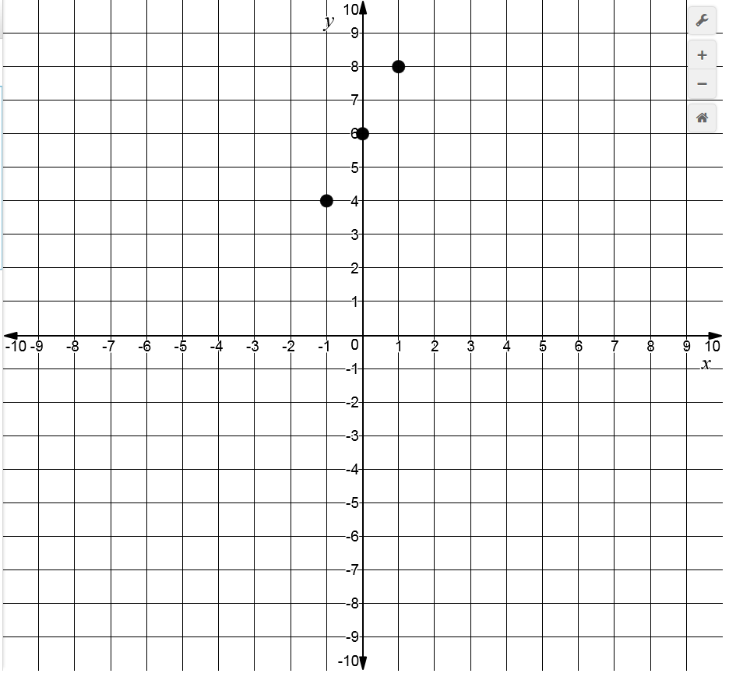
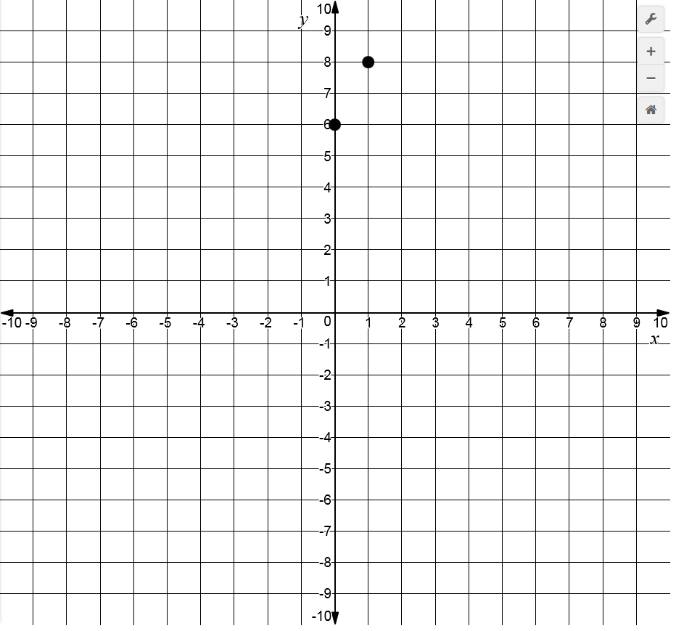









You Try!!
2. Students will be able to use slope-intercept form to graph a linear equation.
Graph $2x−y+6=0$
$$y=2x+6$$
run $=$1
rise $=2$
Find the slope and y-intercept
$$(0,6)$$
rise $=−2$
Slope $=2$
y-intercept = 6
Plot the y-intercept
Use the slope to find another point
Slope $= \frac{rise}{run}=\frac{2}{1}=\frac{−2}{−1}$
Draw a line through the two points
run $=$-1
rise $=−$4
run $=$-2

Slide 18

So let’s review!
What have we covered so far?
Students will be able to find the slope of a line.
m = $\frac{y_{2}−y_{1}}{x_{2}−x_{1}}$
Or line the points up and then subtract.
$$(x_{1},y_{1})$$
$$−(x_{2},y_{2})$$
2. Students will be able to use slope-intercept form to graph a linear equation.
Find the slope and y-intercept
Plot the y-intercept
Use the slope to find another point
Draw a line through the two points

Slide 19
SAT Prac: 4,5,8,15,32

